Slide 1



Advance care planning
Choices for Living & Dying
Notes:
Introduce yourself
Give a bit of background about yourself and how you came to be involved in advance care planning.

Slide 2
Only 25% of Americans…
have put their medical care wishes in writing.
Notes:
Studies show that only about 25% of Americans have written their medical care wishes in a legal document.
Ask Participants:
Why do you think that is? Allow participants to offer suggestions.
A recent poll found that common reasons include:
I don’t want to think about it … morbid, depressing, bad omen
I think it has to involve a lawyer
I’m not at that age
I think it costs too much
I don’t know what to write
I’m intimidated by the forms
Many people don’t know why it’s important to do Advance Care Planning. . . Let’s take a look at one family’s story.

Slide 3


Anna’s story
Notes:
Note to Presenter: Use this case study to provide a story of real events to illustrate the need for Advance Care Planning for everyone – not just the elderly.
Several questions are imbedded in the notes to help participants reflect on and engage the subject matter.

Slide 4
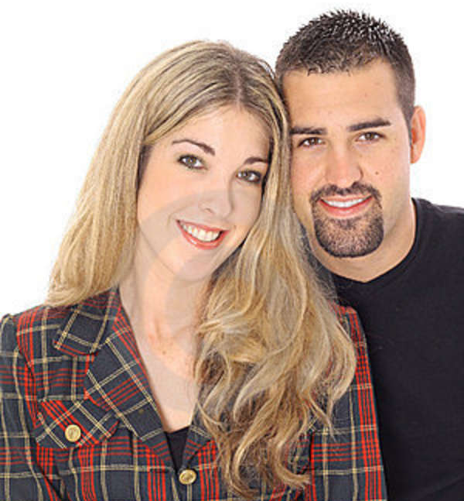
Anna’s experience
Notes:
Anna is a 48 year-old divorced woman with grown children, a son Luis who lives locally and a daughter Carissa who lives in North Carolina. During the past several years she has cared for her widowed father as he was dying. Her father spent the last few weeks of life on a ventilator in an intensive care unit.
Anna did not want to experience a similar scenario if she became seriously ill and were dying.

Slide 5
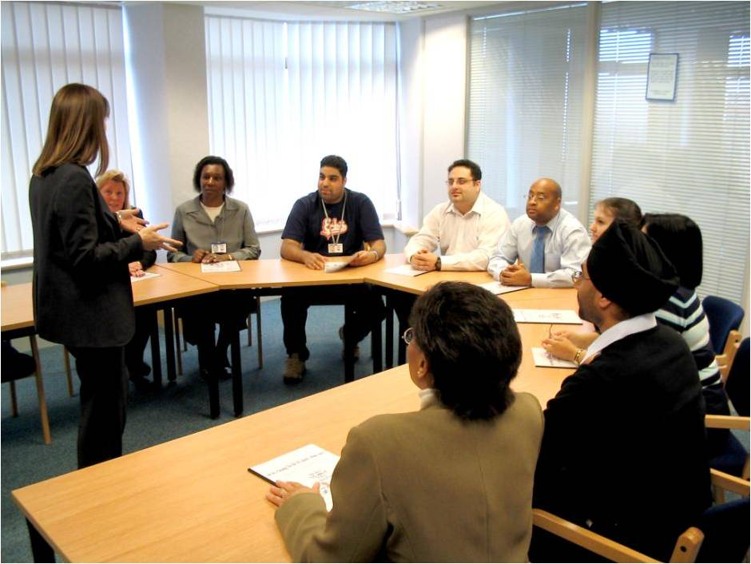

Advance care planning
Notes:
Anna attended an adult education class at her faith community about advance care planning. As part of the class, she completed an Advance Directive designating her daughter, her oldest child, as the agent and documented that she did not want extraordinary measures taken to keep her alive if she became terminally ill or permanently unconscious. Two of her friends in the class witnessed her document.
Anna took her signed Advance Directive home and locked it in her desk with other important papers. She was pleased that she had taken care of that task and felt reassured that her wishes were now documented.
Discussion –
1.) Do you think faith communities can play a role in Advance Care Planning?
A faith community can be a safe place for members to discus their values, wishes for care, and treatment preferences. This can help start a process which leads to having “the conversation” with important people in their lives.
The content of any advance directive should be part of a bigger conversation with family, loved ones, and care providers.
2.) Do you have any concerns about what Anna put in her Advance Directive or what she did with the document?
Any documentation of advance care planning, such as an AHCD or a POLST form, should be given to family, designated decision makers and health care providers. Forms should be kept in an easily accessible and obvious place – not locked away.
3.) What does “extraordinary measures” mean to you?

Slide 6

Facing the unexpected
Notes:
Shortly thereafter Anna received a devastating diagnoses of advance metastatic cancer. She pursued extensive treatment plans in her attempt get better; however, after many months, she was increasingly frail and weak. One day after work, her son came by to visit and found her lying on the floor. She was confused and unable to speak.
Luis called 911, and Anna was taken to the emergency room and admitted to the hospital. When asked if Anna had an Advance Directive, Luis said that he didn’t think so; she never mentioned anything like that to him. Luis told the emergency room physicians that he wanted everything possible done for his mother. She was placed on a ventilator and taken to intensive care.
Discussion:
What challenges do you see in this situation?
What other choices might Luis have considered?

Slide 7
Family members disagree
Notes:
As Anna stabilized, her daughter arrived from North Carolina. She confirmed that her mother had never discussed what she would want done if she were seriously ill, but she could not imagine that her mother would want to be on a ventilator after the experience they had with Anna’s father.
Discussion –
Luis thought everything should be done for his mother and Carissa felt her mother would not want to be on a ventilator.
Do you think this is an unusual situation for these siblings to feel differently about their mother’s care and the perception of her wishes?
Was there anything that would have helped Luis and Carissa to know what their mother wanted and made these decisions easier? (Such as having talked with her and /or received a copy of her Advance Directive or checking with Anna’s friends to see if she has ever said anything about her wishes.)
Why do you think it’s hard for people to have “the conversation”?

Slide 8
Finding an advance healthcare directive
Notes:
Anna was weaned off the ventilator and her condition improved slowly, though she remained weak and tired easily.
She had difficulty finding the energy to speak, but she was no longer confused.
Luis and Carissa arranged for Anna’s transfer to a nursing home where she could be taken care of when Luis went back to work and Carissa returned to North Carolina.
During admission to the nursing home, Anna was asked if she had an Advance Directive. To everyone’s surprise, she nodded her head emphatically and managed to say a quiet “yes.”
Carol found Anna’s Advance Directive locked safely in her desk.
It was a surprise to Luis and Carissa that their mother had designated Carol as the agent/decision-maker, because she had never mentioned it to either of them.
Discussion:
Is there a role here for a faith leader?
How might you be helpful in this scenario?
Suggestions:
Explore options for further discussion about her wishes and what is most important to her at this time of life.
Make sure her children are part of the discussion and are able to support Anna’s choices.
Gently remind the children that the decision maker’s “job” is to follow their mother’s wishes, considering “what would Mom say in this situation?”

Slide 9
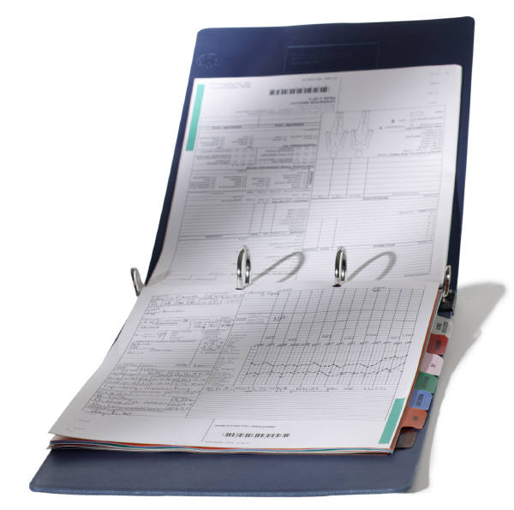
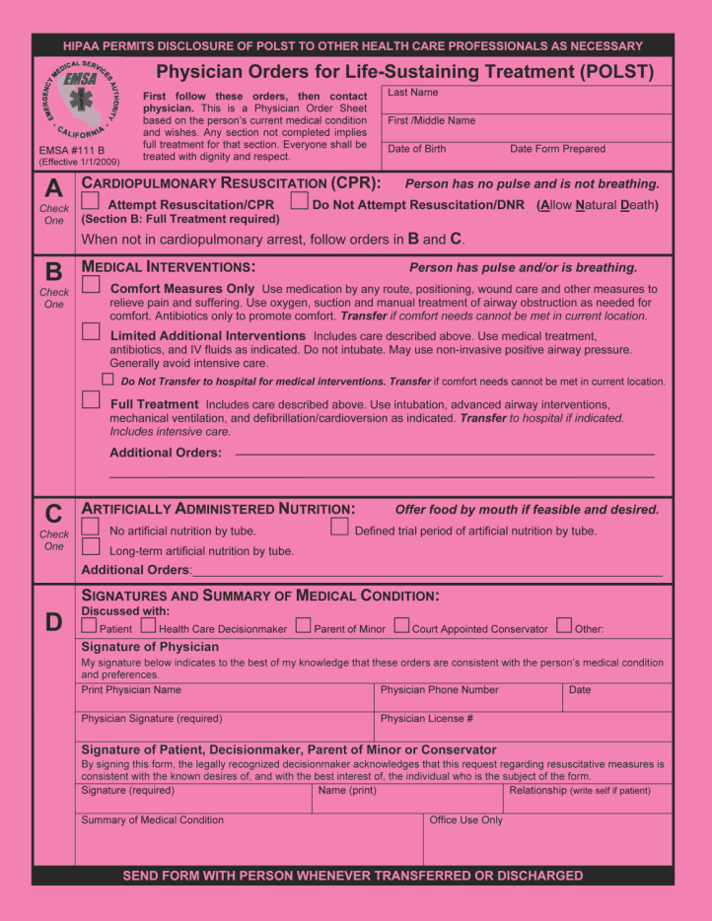
Having the conversation
Notes:
Because of her condition and this recent hospitalization, Anna’s physician wanted to talk with Anna and Carissa about POLST -- Physician Orders for Life-Sustaining Treatment.
Together, they reviewed the treatment choices and Anna’s wishes for the care she wants to receive. These included decisions about CPR (Cardio Pulmonary Resuscitation), artificial nutrition, and hospitalization.
The completed POLST form was placed in her medical chart at the nursing home along with her Advance Directive.

Slide 10
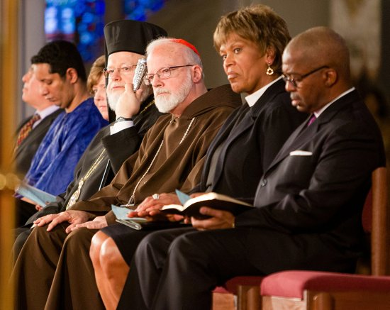
A faith community role
Notes:
The faith community can actively support a member in making healthcare decisions. Since many of these decisions are based on our personal faith and values, having conversations and making decisions in the context of our faith community helps people feel less isolated.
Discussion:
Are there ways that your faith community can provide a safe space to for people begin to have the conversation?
Is there anyone in your congregation who visits the seriously ill and might engage them in a conversation about their healthcare wishes?

Slide 11
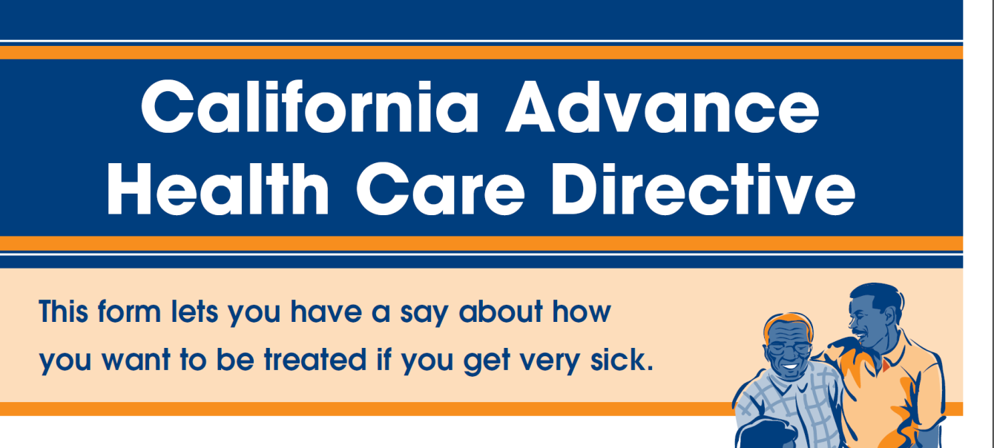
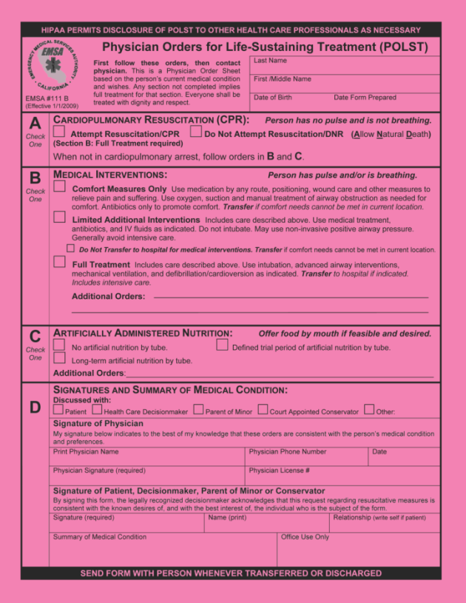
Advance healthcare directives and POLST
Notes:
The original Advance Health Care Directive and POLST forms went home with Anna when she was discharged. She kept them in a plastic sleeve on her refrigerator door where paramedics could easily find them. She also gave copies to Carissa, her closest friend, her son Luis and her doctor.
Designating a legal spokesperson in her Advance Directive and clarifying her wishes with POLST will help assure that Anna receives the type of care that reflects her wishes and values.
The remaining slides provide information about the Advance Directives and POLST, along with ideas for tools to help foster rich conversations among and between families and healthcare providers.

Slide 12
Why plan?
Over 50% not able to make own medical decisions at some point
Default: Treat aggressively even if not desired
Even if hard for family to predict patient wishes
Source: Gundersen Lutheran Medical Foundation, 2002
Notes:
Planning is important. But whether you make plans or not, in most cases decisions about what care you receive will still need to be made.
Research has shown that:
More than half of patients are unable to participate in end-of-life decisions at the time they are being considered. They are often too sick, suffering from dementia, or unconscious.
The health system we have created supports treatment – we wouldn’t want it any other way! Yet when health professionals are uncertain about what the patient would want, the default is to treat, even if the patient wouldn’t want the treatment.
If they have not talked with the patient about his/her wishes, neither health professionals nor even loved ones can reliably predict the patient’s wishes.

Slide 13
The advance care planning process
Reflect about life goals and values
Select decision maker or agent
Talk about you wishes
Complete an Advance Directive
Distribute copies
Review periodically
Notes:
We recommend an Advance Care Planning process which includes the following steps:
Consider your wishes for care – based on your experiences and your cultural and religious views and values.
Select a person to make decisions for you when you are not able to make your own.
Discuss your wishes with your agent/decision maker and other loved ones.
Document your wishes on an Advance Directive document.
Give copies to your decision maker, MD, and loved ones.
Periodically review and edit your Advance Directive if things change.

Slide 14
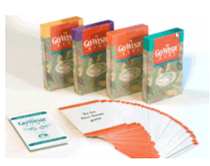

Advance care planning tools
Conversation tools
  Go Wish Cards
  Conversation Project’s Starter Kit
  Coalition for Compassionate Care’s Advance Care Conversation Guide
  CCCC’s Finding Your Way
Notes:
There are lots of tools available for initiating the conversation or to use to reflect on your own values and wishes.
You have a set of Go Wish Cards – There are many ways to use these for conversation starters.
The Conversation Project, The Coalition for Compassionate Care and even the American Bar Association have tools and kits available.
Many religious- and faith-based organizations have developed their own guides and tools.
Spend some time and investigate what is available through your faith tradition.

Slide 15

Personal reflection
Notes:
There are a number of tools available for self reflection:
Leader may pick one of these for use in the seminar:
Distribute personal reflections survey. Ask participants to take 5 minutes to complete.
Discussion: Ask, “Which question was the most difficult for you to answer and why?” or “ Did any of the questions make you feel uncomfortable?” Depending on size of group, have them talk with neighbor about responses either/or ask for responses from the group. Make sure to address question #5: What about the process of dying concerns you most? Be sure to ask them if they have shared that concern with anyone and stress the importance of doing so.
Go Wish exercise; distribute one deck of cards to each person.
Take 5 minutes to look through the cards, and put them in 3 piles:
1) the ones that would be very important to you at the end of life,
2) ones that would be somewhat important, and
3) ones that are not that important.
Then ask them to take a few minutes to rank the items in the very important pile. Finally, go around the room and ask each person to read their most important wish. This gives people ideas for talking with loved ones and shows how individual our preferences can be.

Slide 16

Go Wish exercise
Sort your cards into 3 piles:
Most important to me
Somewhat important to me
Not very important to me
Follow-up instructions after chimes...
Notes:
Go Wish Instructions:
Have them take 3-4 minutes to look through the cards, and put them in 3 piles:
1) the ones that would be very important to you at the end of life, 2) ones that would be somewhat important and
3) ones that are not that important.
Ask them to put aside their “somewhat important” and “not important” piles. With their “Most Important” pile, have them take about 3 minutes to rank those items.
Finally, ask them to choose the MOST important card. Go around the room and ask each person to read their most important wish. This gives people ideas for talking with loved ones and shows how individual our preferences can be (as seen in the variety of responses that people give).

Slide 17

Go Wish exercise
Put aside your two piles of somewhat important and least important cards
With your most important cards, please rank those choices
Notes:
Ask them to put aside their “somewhat important” and “not important” piles. With their “Most Important” pile, have them take about 3 minutes to rank those items.
Finally, ask them to choose the MOST important card. Go around the room and ask each person to read their most important wish. This gives people ideas for talking with loved ones and shows how individual our preferences can be (as seen in the variety of responses that people give).

Slide 18
Why create an advance directive?
A way to make healthcare wishes known if you are unable to communicate.
Allows a person to do either or both of the following:
appoint a decision maker –a healthcare agent.
state instructions for future health care decisions.
Notes:
For those of you who may be unfamiliar with California’s Advance Health Care Directives, it is a way to legally designate someone to speak for you (an agent or decision maker) if you are unable to do so for yourself. It is also a way to make your healthcare wishes known to others.
It is a way to make your healthcare wishes known if you are unable to speak for yourself or prefer someone else to speak for you.
The most important and easiest thing a person can do, particularly if healthy, is appoint a healthcare agent – that is someone to speak for you if you are unable to do so. (Terri Schiavo case)
And it’s also important for your decision maker to know your wishes – to understand how you define a quality life for yourself. Your decision maker should be willing to use substituted judgment, that is, what you would have wanted, when making decisions for you.

Slide 19
Which document do I use?
No single form for California
Several to choose from
Available from:
  hospital social services or chaplaincy
  Coalition for Compassionate Care of California (coalitionccc.org)
  Caring Connections (caringinfo.org)
Notes:
California law is very flexible about forms; There is no one form that is required.
Many hospitals have their own and various organizations including the California Medical Association have them available.
In your binder you have a copies of two free forms. Most hospitals also provide them to their patients at no cost. Contact the Social Services or Chaplaincy Department to get copies.
If you have loved ones living out-of-state, you can download forms for any of the 50 states from Caring Connections at www.caringinfo.org

Slide 20
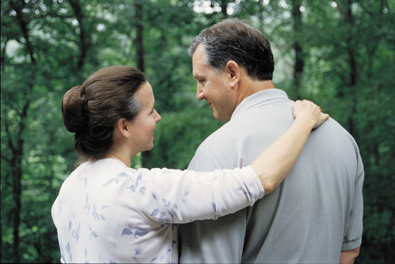
Who do I choose as my agent?
  Familiar with your values
  Willing and able
  Available by phone or in person
  Will prioritize your values over their own
  Comfortable in a medical setting
  Emotional burden not too high
Does not have to be your closest family member
Tell others who you chose
Select an alternate
Notes:
California has no hierarchy of decision makers. While some people may think that the most logical decision maker is the next of kin, that is not required.
In your Advance Directive you
may indicate if there is someone who you do NOT want to be your decision-maker.
assign a legal surrogate/agent which will take precedence over all family members.
select an alternate in case the 1st choice is not available.
What should you consider when selecting an agent?
Who do I trust to make the decisions I want?
Who is most familiar with my views and values?
Who is most likely to be willing to take on responsibility? Are they able to make these often-difficult decisions?
It is important to tell your family members who you choose and why. Since an Advance Directive is usually invoked in a time of crisis or great emotion, it is not the best time to spring on the family that mom asked the youngest daughter to speak for her. It can be difficult for a family member to face not only the serious illness of a loved one but also the knowledge that someone else was asked to make decisions.

Slide 21
What makes an
Advance Directive legal?
Your signature and date
The signatures of two witnesses or a notary
If you are in a nursing home, the signature of the patient advocate or ombudsman
Notes:
There is nothing magical about a particular form.
You could write your wishes on a yellow tablet and it would be legal, as long as it has at least these things:
Your signature and the date
2. The signatures of 2 qualified witnesses (see below) or have the signature notarized
Qualified witnesses are:
18 years of age
not the appointed healthcare decision maker
not the person’s healthcare provider or an employee of the provider (unless they are a family member)
not an employee of a nursing or residential care facility where the person lives (unless they are a family member)
One of the witnesses must not be related to the person or entitled to any part of the estate
Witnesses are testifying that you are the person signing the document; they do not need to read nor agree with the document.
3. If you are in a nursing home, the form must be signed by the ombudsman.

Slide 22
What kinds of instructions can be included in an Advance Directive?
Where you would like to be when you die
MD preference
Accepting or refusing life-sustaining treatment
Quality of life considerations
Organ/tissue donation instructions
Notes:
Your instructions can be as specific as you care to make them. They might include things like:
Where you would prefer to die, e.g., at home, the hospital …..
What doctor you want to care for you
Your thoughts on accepting or refusing particular treatments like CPR, artificial nutrition and hydration, breathing machines etc.
Unless you know the exact situation you may face, it can be difficult to make decisions about specific treatments. For example, you may want a ventilator if it gets you through a crisis during a serious illness. And, CPR is often appropriate for an otherwise healthy adult.
It may help to think about the goals of treatment. For example, I would want to be at home … to be conscious and able to communicate with my loved ones … to have my pain controlled.
Any instructions related to whether or not you want to make organ and tissue donations.

Slide 23
What do I do with the Advance Directive?
Give a copy to your healthcare agent.
Make copies for loved ones.
Discuss with doctor; get in medical record.
Keep a copy yourself.
Take it with you to the hospital.
Photocopies are just as valid as original.
Notes:
The most important thing to remember -- this is not a secret document.
It is not like a will. Don’t lock it up in a desk or put in your safe deposit box.
Make sure your decision maker has a copy—and that you’ve discussed with him/her what your wishes are.
Give a copy to your doctor at your next appointment, or make a specific appointment to discuss it with him or her. Ask your doctor to put a copy in your medical record.
Don’t rely on that medical record however; take it with you if you go to the hospital. Never assume that it will follow you around. It often gets misplaced or isn’t checked.
Copies are just as valid as the original.

Slide 24
POLST
Physician Orders for
Life-Sustaining Treatment
Physician Orders for Life-Sustaining Treatment
Notes:
Depending up on how you have set up the participant binders you may direct them to look in their binders, pass out copies or pass a copy around.
You may choose to have these in the back pocket of the participant binders or pass them out.

Slide 25
What is POLST?
For people who are seriously ill.
Tells your exact wishes about certain medical treatments.
A signed medical order that your health care team can act on.
Bright pink form for all of California.
It goes where you go.
Notes:
So, what is POLST? [INSTRUCTORS: Pull out your POLST form to show, also in binder]
It is for people with chronic, progressive, serious health conditions or the medically frail
It is a doctor’s order that is recognized throughout the medical system.
Meant to be filled out in conversation with your doctor or medical team, but it should also be shared with your family.
It is easily distinguished by its bright pink color.
It is a standardized form for the whole state.
It can be changed at any time
It is a portable document that transfers with the patient from one care setting to another.

Slide 26
POLST vs. Advance HealthCare Directive
AHCD | POLST
For anyone 18 and older | For seriously ill or frail, at any age
General instructions for future treatment | Specific orders for current treatment
Names medical decision maker | Can be signed by decision maker
Notes:
Advance Health Care Directive:
Everyone 18 years and older should have an Advance Directive.
It is a legal document completed in advance that allows you to:
make general statements about your future healthcare wishes, and
appoint a healthcare decisionmaker to speak on your behalf.
There are many valid versions of the form.
POLST:
Though anyone can have a POLST form, it is designed for those who are seriously ill or very frail – at any age.
It is a medical order that documents wishes for treatment at the current time; it is often completed in a medical setting.
It can be signed by the patient’s decisionmaker if the patient lacks decisionmaking capacity; it can also be completed by the patient’s decisionmaker in consultation with the patient’s physician.
There is one form for all of California.

Slide 27
Where do I keep my completed POLST form?
The original stays with you!
At home:
  Keep in easy-to-find location
  Give to emergency medical services
At a nursing home or hospital:
  Filed in medical chart
  Goes with you if you are transferred
Notes:
The bright pink POLST form stays with you at all times.
Keep the POLST in an easy-to-find location at home – for example, on the refrigerator, hanging on a wall by your bed, or with your medications.
If Emergency Medical Services are called, your family should give them your POLST form when they arrive. The POLST form will go with you to the hospital.
If you are in a hospital or nursing home, the POLST form will be kept in your medical chart.
It is helpful to keep the POLST form, along with your Advance Directive , in a plastic sleeve.

Slide 28
Advance care planning continuum
Age 18
Complete an Advance Directive
C
O
N
V
E
R
S
A
T
I
O
N
Update Advance Directive Periodically
Diagnosed with Serious or Chronic, Progressive Illness (at any age)
Complete a POLST Form
Treatment Wishes Honored
Notes:
The Advance Care Planning Continuum
It starts at age 18 with completing an Advance Directive.
Your Advance Directive should be updated periodically throughout your life – check names, contact information, and healthcare wishes.
If you are diagnosed with a serious or chronic, progressive illness at any age, talk with your physician about completing a POLST form.
The goal is to ensure that your treatment wishes are honored.
What is the word along the left side? Conversation.
An ongoing conversations over the years with your designated healthcare decisionmaker, family, and healthcare provider is the key!

Slide 29
What happens if there is no Advance Directive?
A physician or medical team will pick someone to make choices for you.
This may be the person who is most available
  The person who brought you in
  The most vocal person
  The person who visits the most often
Notes:
A physician or the medical team may determine who makes your decisions if you are unable
.
These choices may be made, on your behalf, with careful consideration to who knows you the best and knows your wishes.
Or it may be:
The most available person, the person who came with you to the hospital, the most vocal person, the person who visits the most.
This person is expected to make decisions based on substituted judgment (what you would have wanted) but this may not be the care.
In some cases it may be what the person “thinks” you would want, what the person wants, or what they think is “best” for you.
It is very important for everyone to talk to loved ones about their healthcare wishes and assign someone to make decisions for them.

Slide 30

Advance care planning: a process and a conversation
Reflect
Select agent
Discuss
Complete form
Distribute
Review
Peace of Mind
Notes:
Advance care planning is a process. It will help ensure that:
you receive the health care you want.
you live fully and comfortably in your final days.
relieve the burden on your loved ones.
Take home Message: Discuss your wishes and complete an Advance Directive. If appropriate, talk to your doctor about POLST.

